Slide 1

Sr 141/peachtree parkway at medlock bridge road/east jones bridge road intersection improvements public MEETING
SEPTEMBER 5, 2019

Slide 2
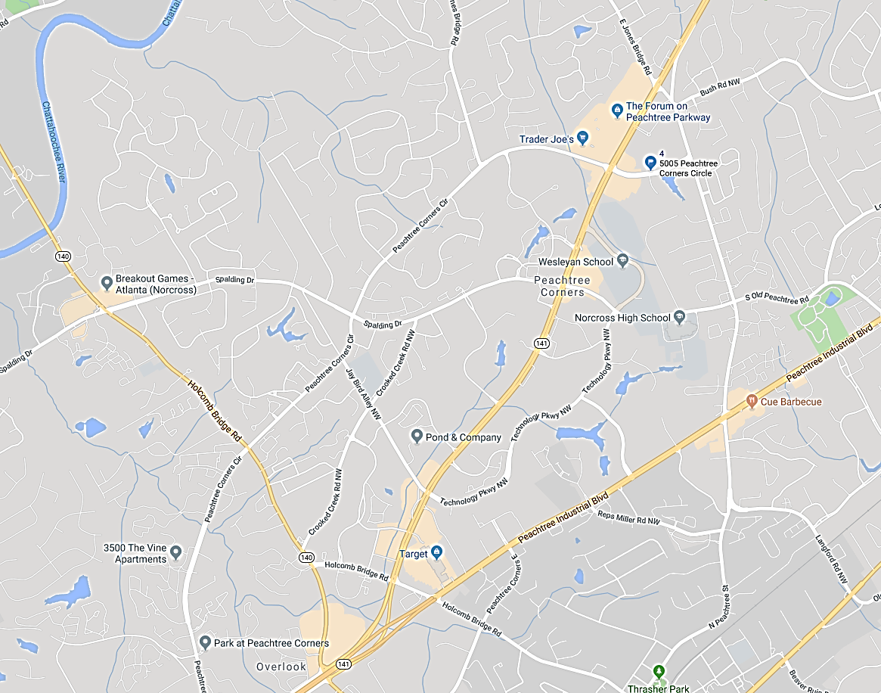
Project Location
N
East Jones
Bridge Road
Project Location
Peachtree Corners Circle
Medlock Bridge Road
SR 141/Peachtree Parkway
Peachtree Industrial Boulevard
Holcomb Bridge Road

Slide 3
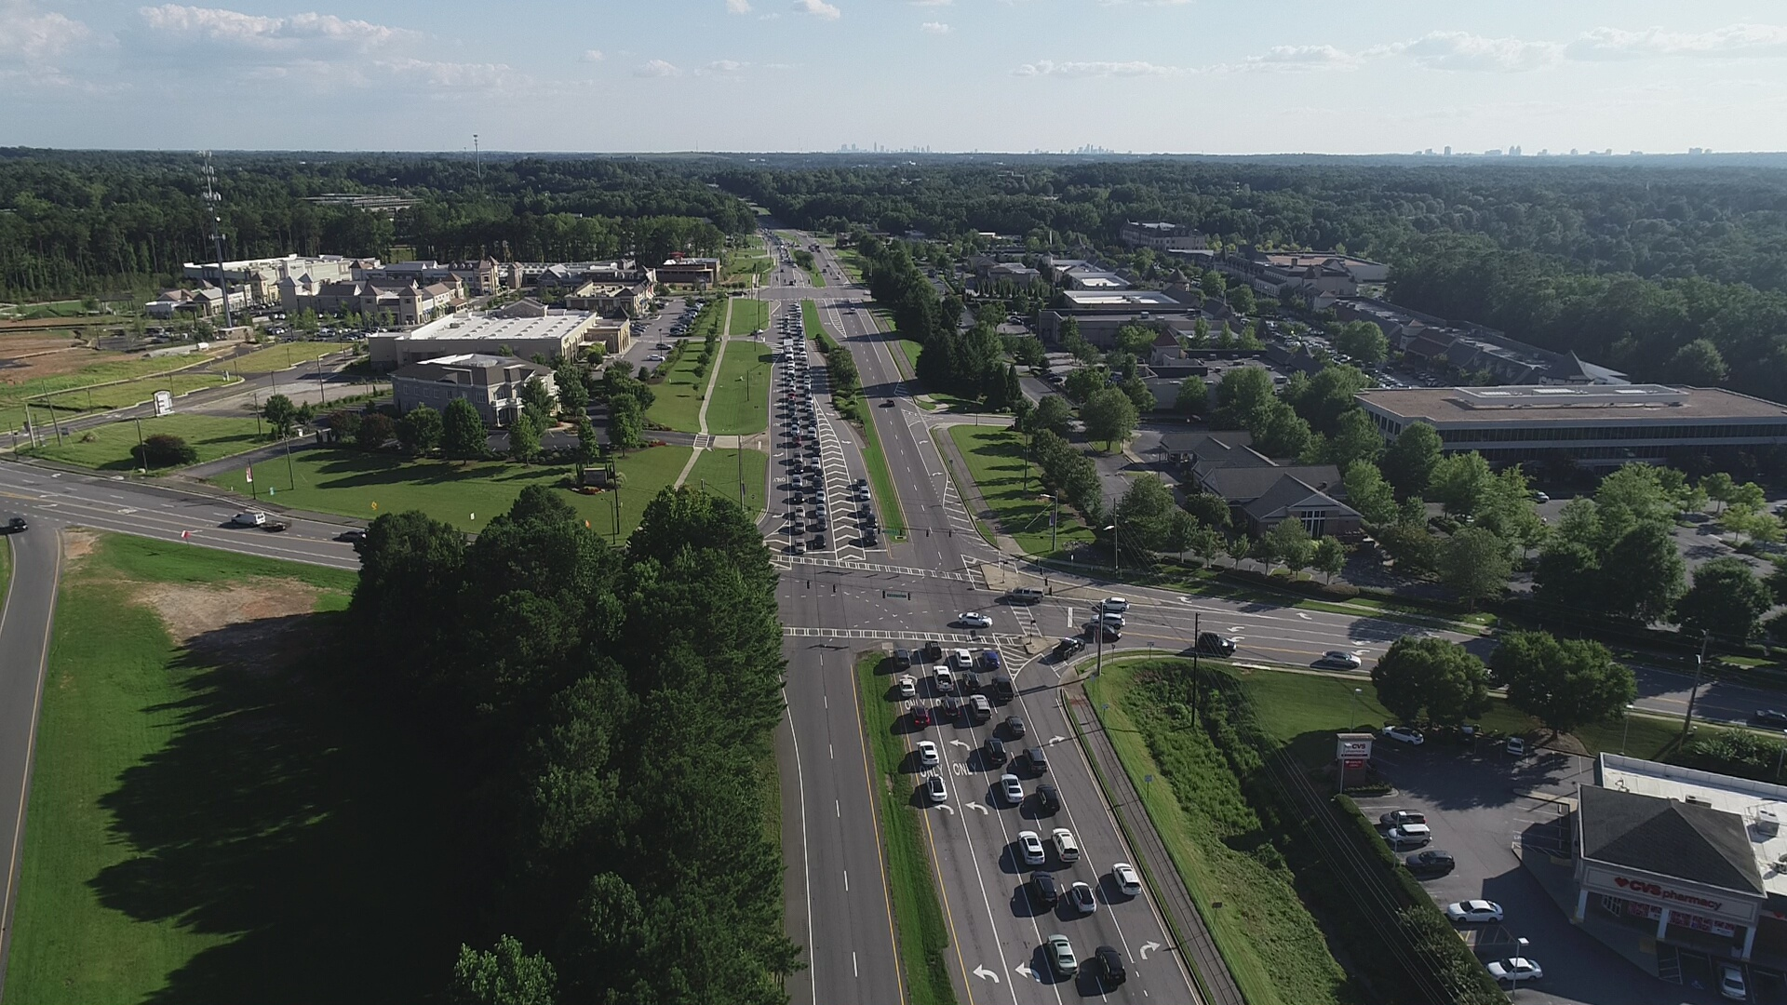

Slide 4
Project history
SR 141 Corridor Study:
SR 141 Corridor Study Kickoff: Fall 2016
PIOH #1 (gather public input): Spring 2017
PIOH #2 (present alternatives): Fall 2017
City Council Meeting Presentation: Winter 2017
Study Accepted: Winter 2017

Slide 5
Project history
SR 141 at E Jones Bridge Road / Medlock Bridge Evaluation:
Evaluation kickoff: Spring 2018
Evaluation submitted to GDOT: Fall 2018
Public Meeting: Today, September 5, 2019

Slide 6
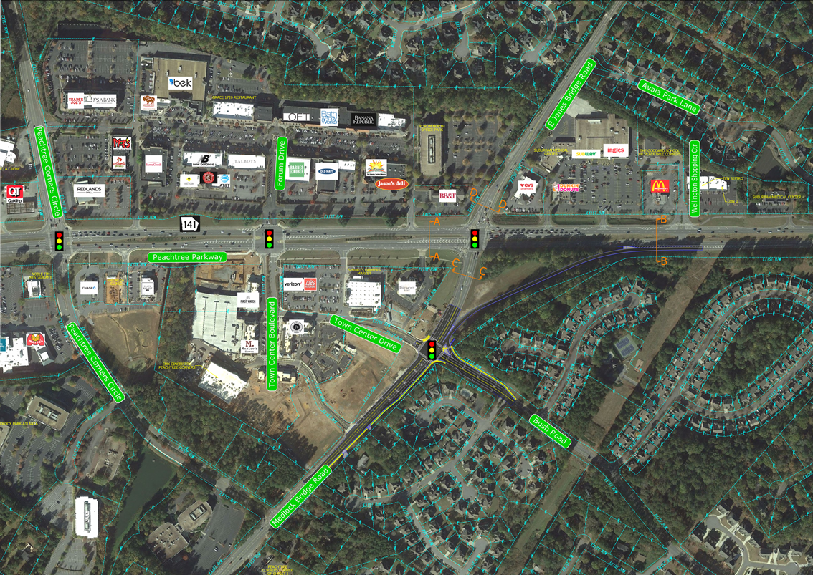
Alternative #1: no build

Slide 7






Alternative #1: no build

Slide 8
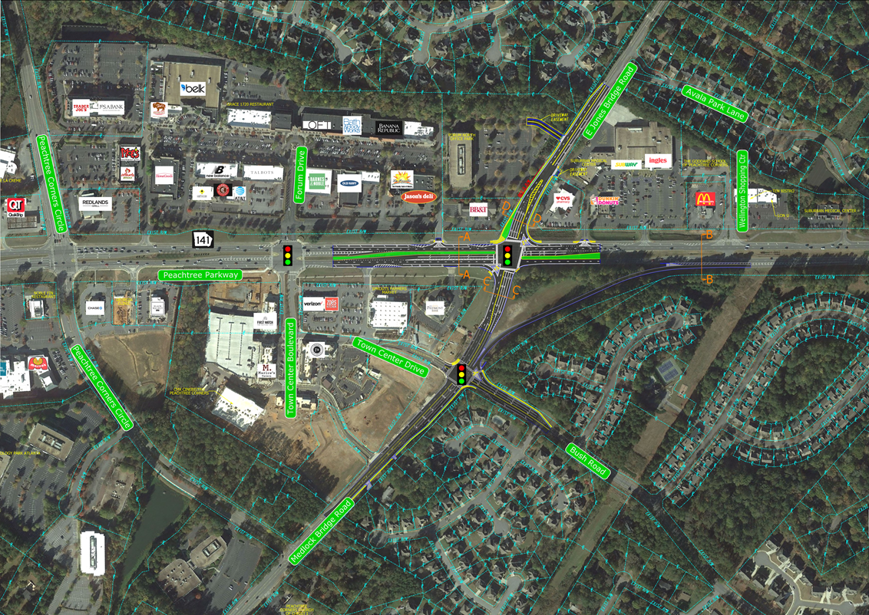
Alternative #2: conventional intersection improvements

Slide 9
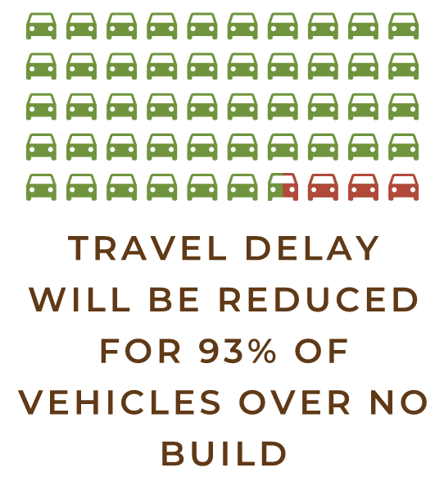




Alternative #2: Conventional Intersection improvements

Slide 10
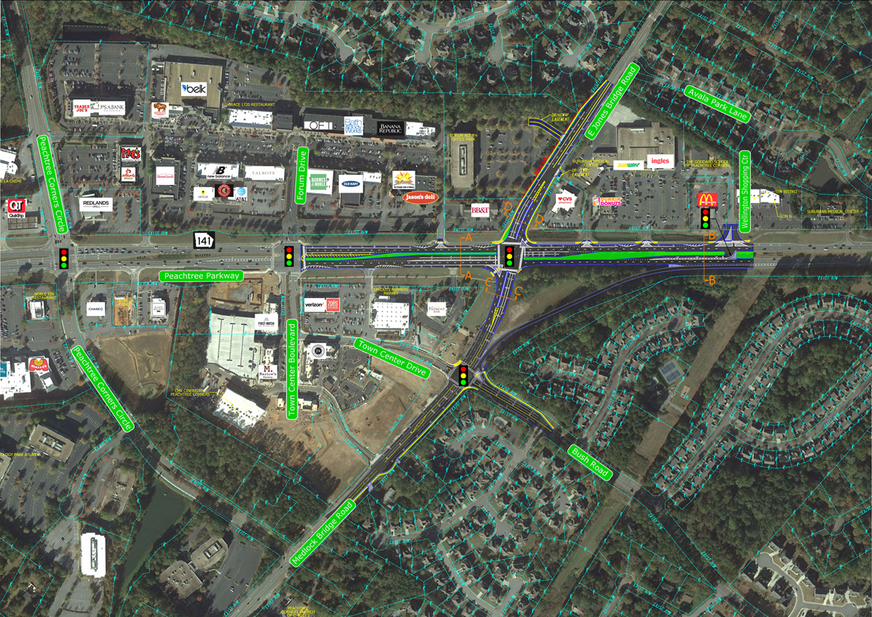
Alternative #3: MEDIAN U-TURN

Slide 11
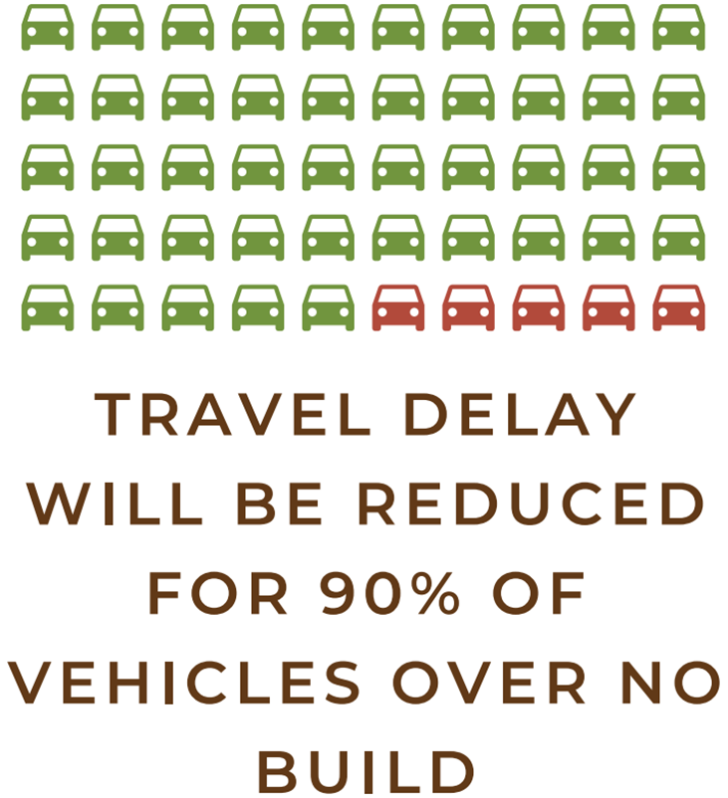


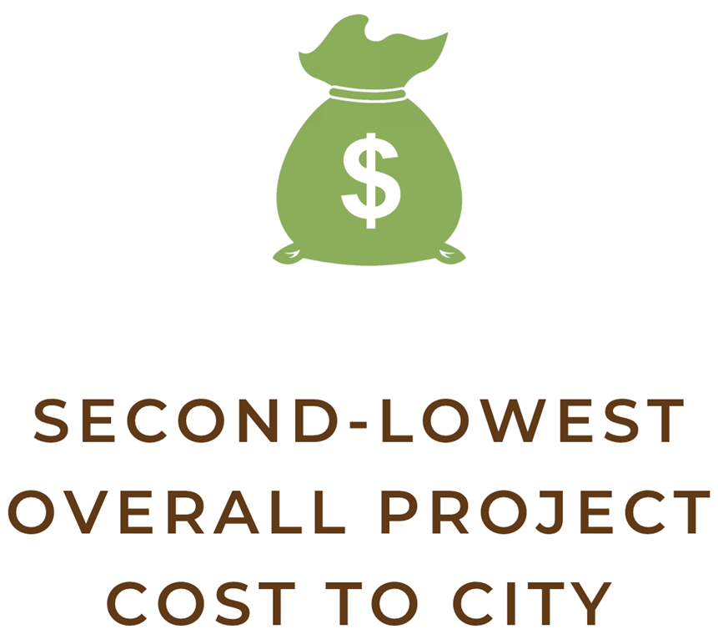


Alternative #3: Median U-Turn

Slide 12
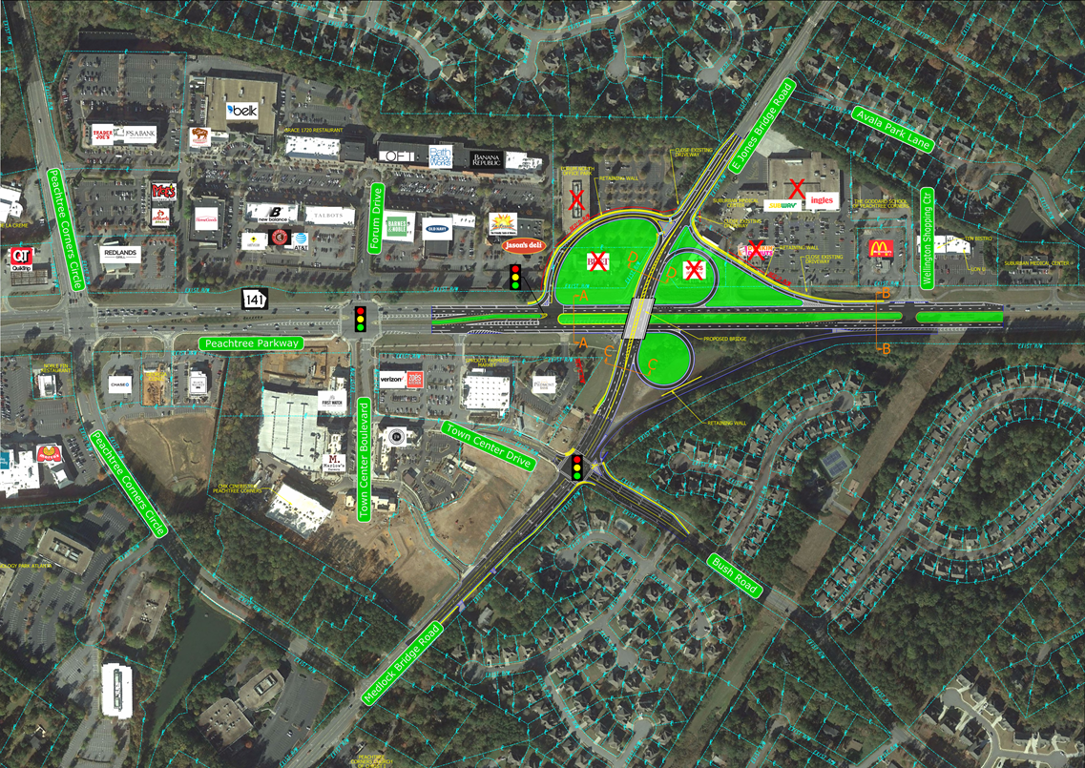
Alternative #4: GRADE SEPARATED INTERCHANGE

Slide 13
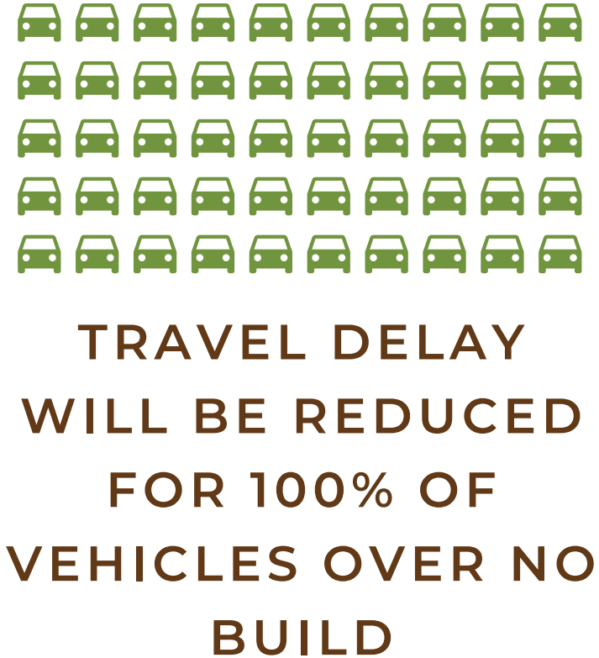


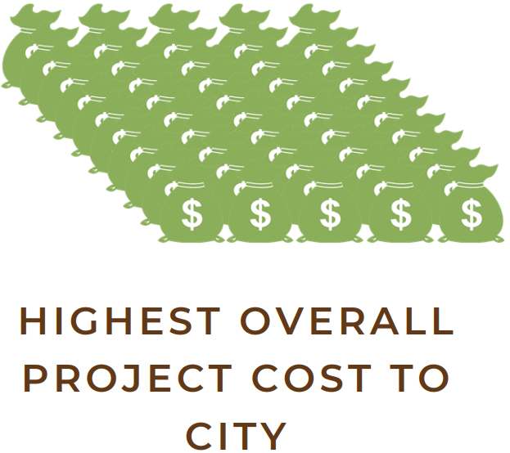


Alternative #4: GRADE SEPARATED INTERCHANGE

Slide 14
COMMENT CARD SUBMISSIONS
You can provide your feedback by:
Filling out the comment card provided and dropping it in the comment box
Emailing your response to publicworks@peachtreecornersga.gov
Deadline for comments is 9/30/19

Slide 15
Questions?

